Slide 1

Database Systems:
Design, Implementation, and Management
Tenth Edition
Chapter 10
Transaction Management
and Concurrency Control

Slide 2
Objectives
In this chapter, you will learn:
  About database transactions and their properties
  What concurrency control is and what role it plays in maintaining the database’s integrity
  What locking methods are and how they work
Database Systems, 10th Edition

Slide 3
Objectives (cont’d.)
  How stamping methods are used for concurrency control
  How optimistic methods are used for concurrency control
  How database recovery management is used to maintain database integrity
Database Systems, 10th Edition

Slide 4
What Is a Transaction?
Logical unit of work that must be either entirely completed or aborted
Successful transaction changes database from one consistent state to another
  One in which all data integrity constraints are satisfied
Most real-world database transactions are formed by two or more database requests
  Equivalent of a single SQL statement in an application program or transaction
Database Systems, 10th Edition

Slide 5
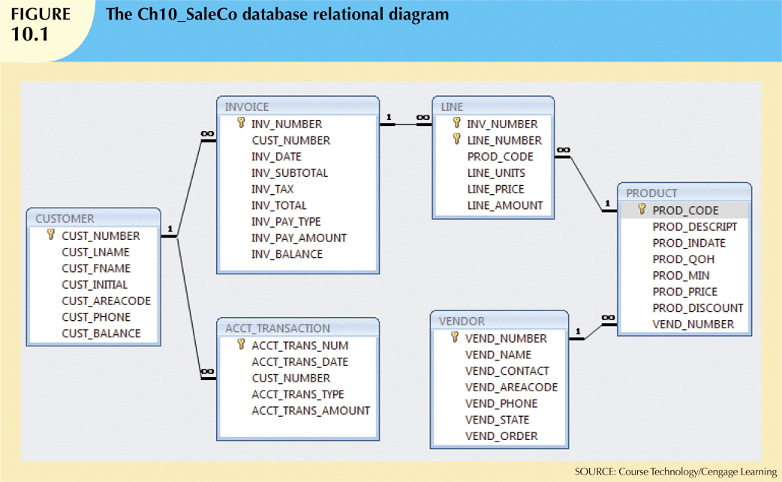
Database Systems, 10th Edition

Slide 6
Evaluating Transaction Results
Not all transactions update database
SQL code represents a transaction because database was accessed
Improper or incomplete transactions can have devastating effect on database integrity
  Some DBMSs provide means by which user can define enforceable constraints
  Other integrity rules are enforced automatically by the DBMS
Database Systems, 10th Edition

Slide 7
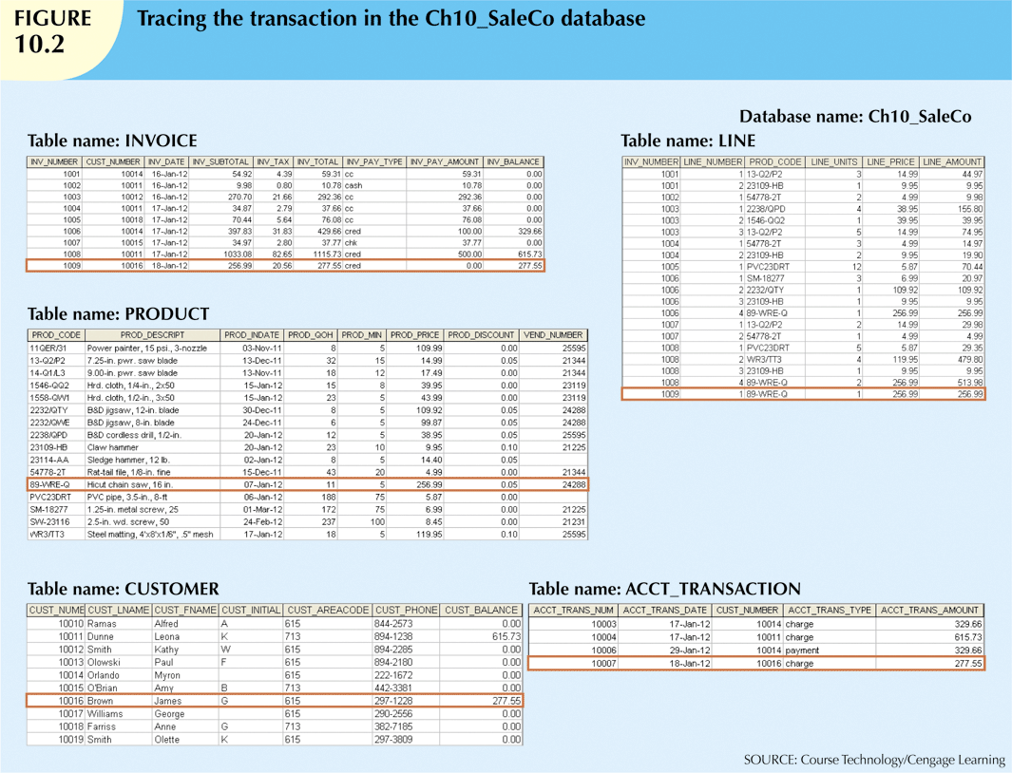
Figure 9.2
Database Systems, 10th Edition

Slide 8
Transaction Properties
Atomicity
  All operations of a transaction must be completed
Consistency
  Permanence of database’s consistent state
Isolation
  Data used during transaction cannot be used by second transaction until the first is completed
Database Systems, 10th Edition

Slide 9
Transaction Properties (cont’d.)
Durability
  Once transactions are committed, they cannot be undone
Serializability
  Concurrent execution of several transactions yields consistent results
Multiuser databases are subject to multiple concurrent transactions
Database Systems, 10th Edition

Slide 10
Transaction Management with SQL
ANSI has defined standards that govern SQL database transactions
Transaction support is provided by two SQL statements: COMMIT and ROLLBACK
Transaction sequence must continue until:
  COMMIT statement is reached
  ROLLBACK statement is reached
  End of program is reached
  Program is abnormally terminated
Database Systems, 10th Edition

Slide 11
The Transaction Log
Transaction log stores:
  A record for the beginning of transaction
  For each transaction component:
    Type of operation being performed (update, delete, insert)
    Names of objects affected by transaction
    “Before” and “after” values for updated fields
    Pointers to previous and next transaction log entries for the same transaction
  Ending (COMMIT) of the transaction
Database Systems, 10th Edition

Slide 12
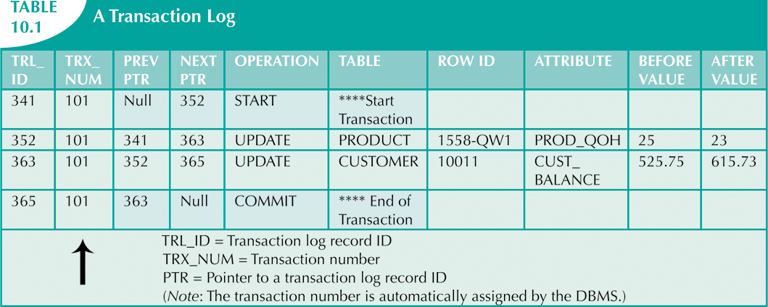
Database Systems, 10th Edition

Slide 13
Concurrency Control
Coordination of simultaneous transaction execution in a multiprocessing database
Objective is to ensure serializability of transactions in a multiuser environment
Three main problems:
  Lost updates
  Uncommitted data
  Inconsistent retrievals
Database Systems, 10th Edition

Slide 14
Lost Updates
Lost update problem:
  Two concurrent transactions update same data element
  One of the updates is lost
    Overwritten by the other transaction
Database Systems, 10th Edition

Slide 15
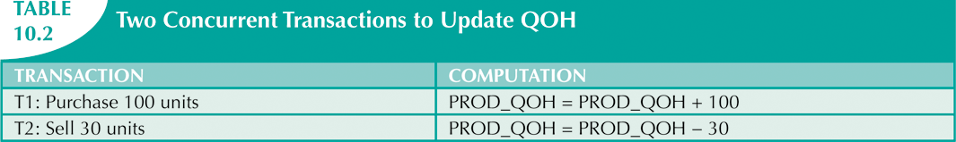
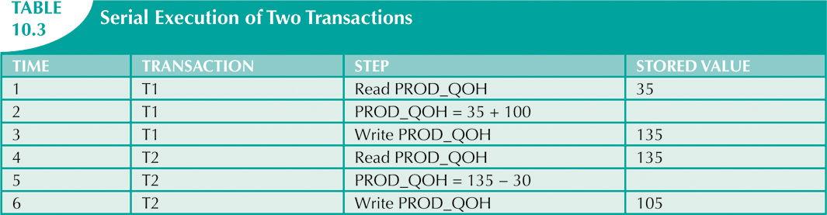
Database Systems, 10th Edition

Slide 16
Uncommitted Data
Uncommitted data phenomenon:
  Two transactions are executed concurrently
  First transaction rolled back after second already accessed uncommitted data
Database Systems, 10th Edition

Slide 17
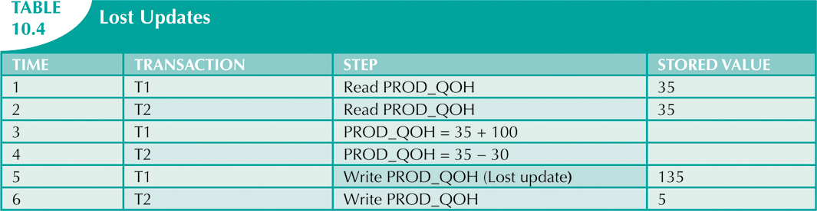

Database Systems, 10th Edition

Slide 18
Inconsistent Retrievals
Inconsistent retrievals:
  First transaction accesses data
  Second transaction alters the data
  First transaction accesses the data again
Transaction might read some data before they are changed and other data after changed
Yields inconsistent results
Database Systems, 10th Edition

Slide 19
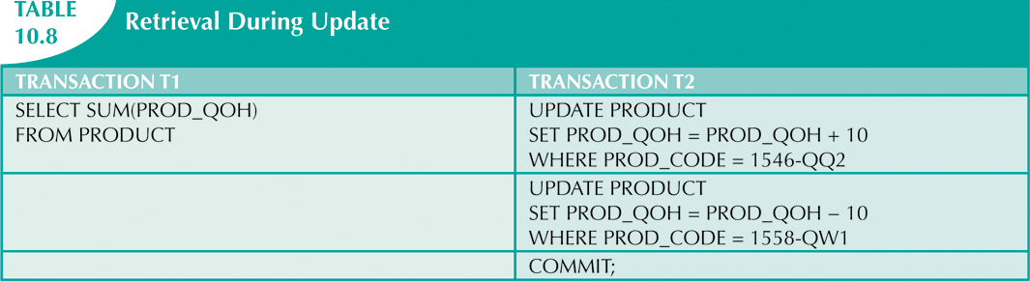
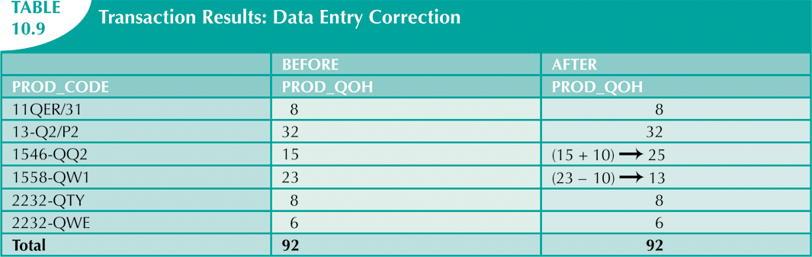
Database Systems, 10th Edition

Slide 20
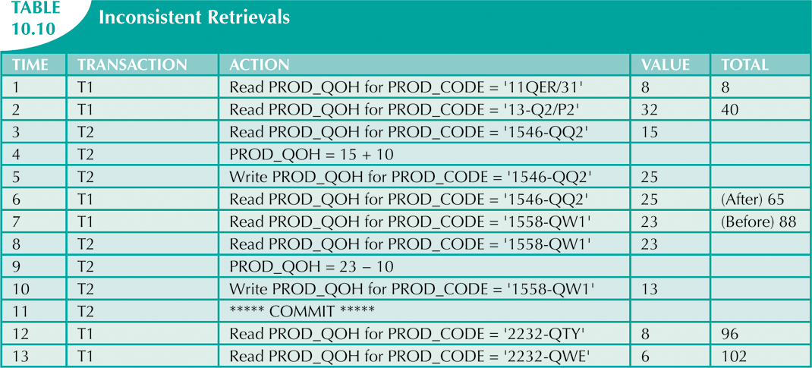
Database Systems, 10th Edition

Slide 21
The Scheduler
Special DBMS program
  Purpose is to establish order of operations within which concurrent transactions are executed
Interleaves execution of database operations:
  Ensures serializability
  Ensures isolation
Serializable schedule
  Interleaved execution of transactions yields same results as serial execution
Database Systems, 10th Edition

Slide 22
Concurrency Control with Locking Methods
Lock
  Guarantees exclusive use of a data item to a current transaction
  Required to prevent another transaction from reading inconsistent data
  Pessimistic locking
    Use of locks based on the assumption that conflict between transactions is likely
  Lock manager
    Responsible for assigning and policing the locks used by transactions
Database Systems, 10th Edition

Slide 23
Deadlocks
Condition that occurs when two transactions wait for each other to unlock data
Possible only if one of the transactions wants to obtain an exclusive lock on a data item
  No deadlock condition can exist among shared locks
Database Systems, 10th Edition

Slide 24
Deadlocks (cont’d.)
Three techniques to control deadlock:
  Prevention
  Detection
  Avoidance
Choice of deadlock control method depends on database environment
  Low probability of deadlock; detection recommended
  High probability; prevention recommended
Database Systems, 10th Edition

